Slide 1
CNN 기반 이미지 분류
15011044 송창석
15011047 최태호
15011050 조한국

Slide 2

3팀 15.466초

Slide 3
Convolution
Work item
D1
…
3
2
1
0

Slide 4
Convolution
Input order
D1
0
…
3000 images
sequential
…
3
0
parallel
2
0
1
0
0
0

Slide 5
Convolution {16, 16, 1}
32*32 image
…
16*16
16*16
3000 images
use same filter
16*16
16*16

Slide 6
Convolution {16, 16, 1}
16*16 image
…
3000 images
use same filter
16*16

Slide 7
Convolution {8, 8, 4}
8*8 image
…
Max work group size
256/(8*8) = 4
8*8
3000 images
use same filter
Work group size: 4 channel
3000%4 == 0

Slide 8
Convolution {4, 4, 15}
4*4 image
…
Max work group size
256/(4*4) = 16
…
4*4
3000 images
use same filter
Max Work group size: 16 channel
3000%16 != 0
So set work group size 15

Slide 9
Convolution {2, 2, 60}
2*2 image
…
Max work group size
256/(2*2) = 64
…
2*2
3000 images
use same filter
Max Work group size: 16 channel
3000%64 != 0
So set work group size 60

Slide 10
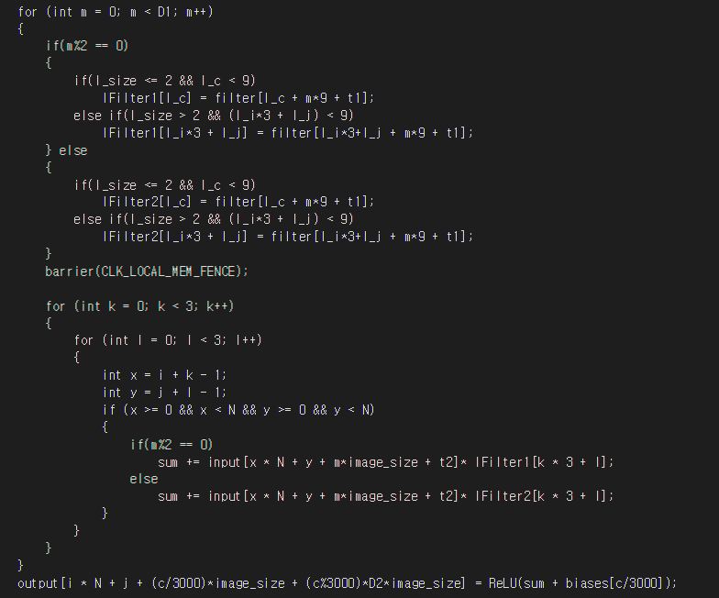
Convolution

Slide 11
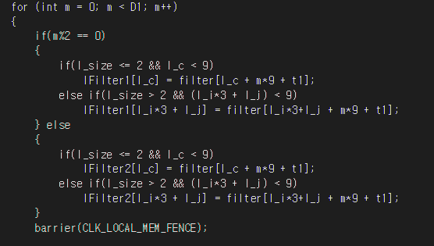
Convolution local memory

Slide 12
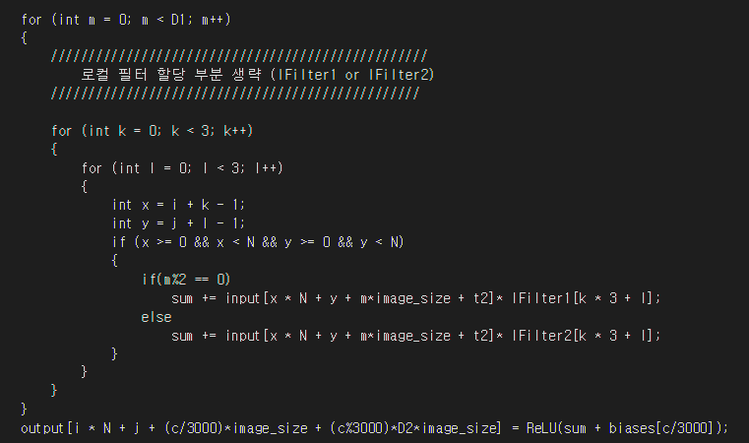
Convolution 연산

Slide 13
Full Connection {1, 250}
3000 images
.
.
.
.
.
.
.
.
.
. . .
.
.
.
.
.
.
.
.
.
3000%256 != 0
So set work group size 250

Slide 14
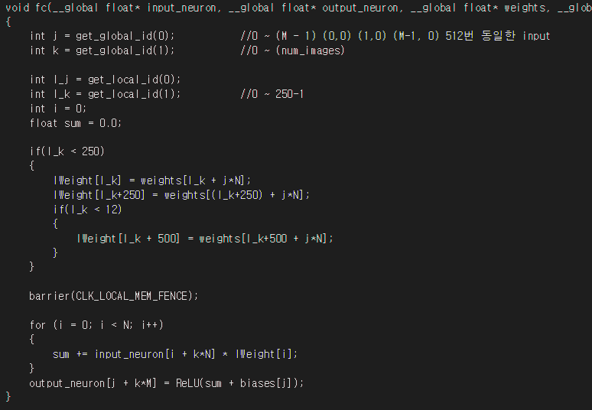
Full Connection

Slide 15


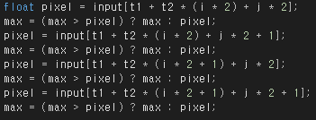
Some technics
Loop invariant code
Loop unrolling

Slide 16
Some technics
Set kernel argument properly
Convolution 1-1
Convolution 1-2

Slide 17
QnA

